Slide 1




Coding for strangers
Paul Broadwith
@pauby pauby.com github.com/pauby
Paul Broadwith @pauby

Slide 2
Four ways to use powershell
Console
Script
Module

Slide 3
10 do’s and don’t of powershell
Develop a style and stick to it
Use Advanced Functions
Leverage built-in validation
Name your things Use full cmdlet and parameter names – not aliases or positions
Filter left, format right
Go green with your code – Reduce, Reuse and Recycle
Use Write-Verbose to comment
Save the world by writing help
Use the pipeline and objects
Don’t pollute the users session (don’t use $ErrorActionPreference or global stuff / Be aware of Scope / don’t use CLS)

Slide 4
10 do’s and don’t of powershell
Why are they important
If you leave, get sick or get hit by a bus somebody else can pick it up
Peer review
Post script online such as PowerShell Gallery, Github

Slide 5
Develop a style and stick to it

Slide 6
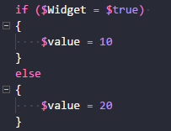
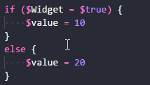
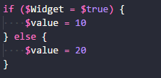


Develop a style and stick to it
Choose a bracing style:
Choose a naming style:
$myVar, $myvar, $my_var are all valid variable names
Get-Thing, getthing and get_thing are all valid function names

Slide 7
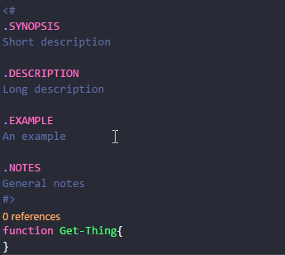
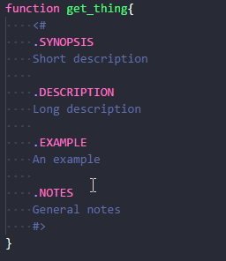


Develop a style and stick to it
https://github.com/PoshCode/PowerShellPracticeAndStyle
Choose a help style:
Choose a comment style:
Whatever you choose, BE CONSISTENT!

Slide 8
Use advanced functions

Slide 9
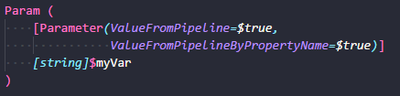
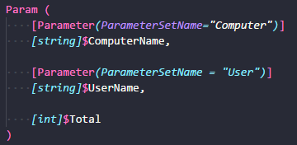
Why Use advanced functions
Allows your function to accept -Verbose, -Debug, -WhatIf, -Confirm, -ErrorAction and others.
Access to the pipeline
Use Parameter Sets

Slide 10
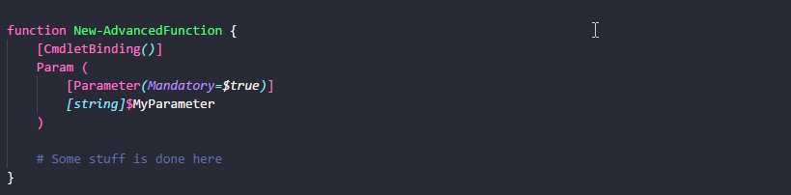
Use advanced functions
Define advanced function using [CmdletBinding()]
Use man about_Functions_Advanced

Slide 11
Leverage built-in validation

Slide 12

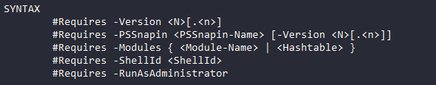
Leverage built-in validation
Parameter Attributes
Mandatory – prompts if parameter is missing.
HelpMessage –what is required
#Requires statement
States code pre-requisites
Set-StrictMode statement
Generates a terminating error when basic best-practice coding rules are violated

Slide 13
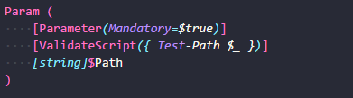
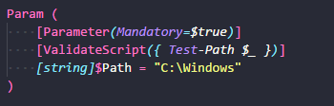
Leverage built-in validation
Validation attributes
[ValidateCount(min, max)]
[ValidateLength(min, max)]
[ValidatePattern(<REGEX>)]
[ValidateScript({<SCRIPTBLOCK>})]
Assign defaults to parameters

Slide 14
Name your things

Slide 15
Name your things
Users expect your PowerShell to taste like real PowerShell
Use common parameter names
-Path, -Computername, -Destination
Use singular naming
Get-Item, Get-ADUser, Add-AppxPackage

Slide 16
Name your things
Use descriptive names for variables, parameters and functions:
$
$strVar
Avoid Hungarian Notation – PowerShell is a dynamically typed language!
function intGet-Number{}

Slide 17

Commenting your code
Code should almost comment itself
Use Write-Verbose to comment your code
Displayed on the host when the function is called with the –Verbose parameter
Describes your code as you go
Comment for somebody else
You know what it does and how it does it, the rest of the world does not!

Slide 18

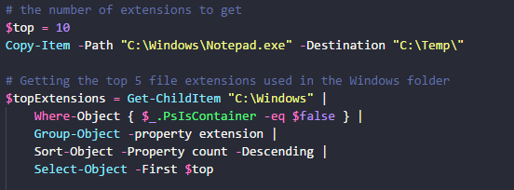
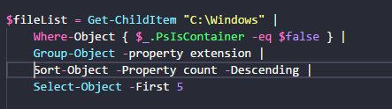
Commenting contentment
Comments should not explain the obvious
Comments should be used to explain the not-so-obvious

Slide 19
Help ON HELP
Says what your code does
.SYNOPSIS
.DESCRIPTION
Says what parameters are available, how and required
.PARAMETER
Gives a demo of how to use the code
.EXAMPLE
Add help to each function you write as you go along – don’t pretend you will do it later!

Slide 20
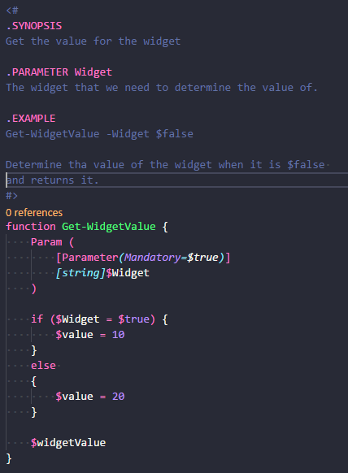


WRITING help
As a minimum add:
.SYNOPSIS
Tweet length description of your code
.PARAMETER
One for each parameter
Say what it’s used for
.EXAMPLE
One or two examples of using your code
Used as a basis for unit testing (with Pester)
Use <# before or within a function
QUICKLY ADD HELP TO YOUR CODE
Use Control-J and select Cmdlet (advanced function)

Slide 21
Poluting pipeline

Slide 22
Bad practice

Slide 23
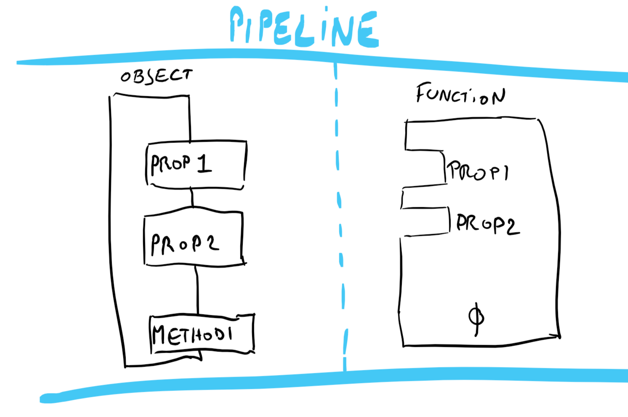
It’s all about the Pipeline

Slide 24
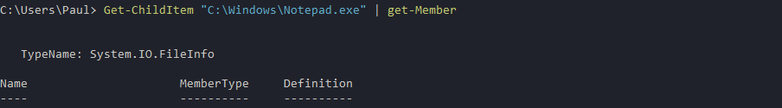
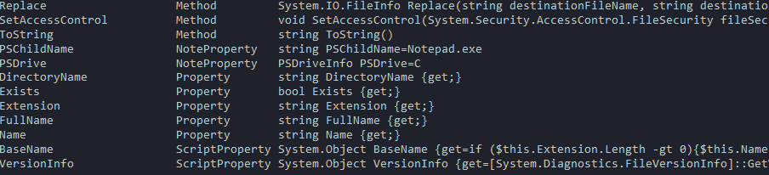
objects
Anatomy of an object:
Properties
Size
Length
Name
Methods
Trim()
ToString()

Slide 25
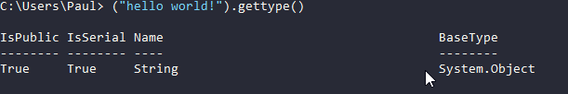
objects
EVERYTHING in PowerShell is an object

Slide 26
Creating your own objects
Create your own objects for output
Bend the output of other cmdlets to your will!

Slide 27
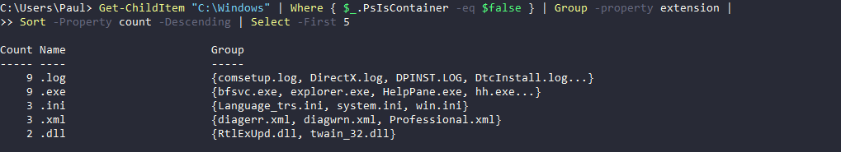
Use The pipeline
Most cmdlets use the pipeline
Code to use the pipeline
Allows cmdlets and functions to be chained together

Slide 28
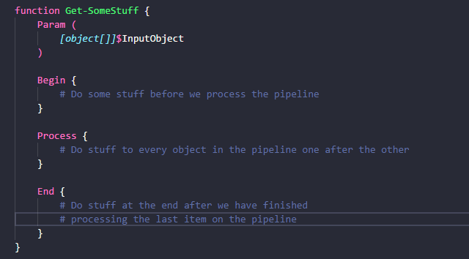
Use The pipeline
Code to use the pipeline

Slide 29
The powershell taste experience
Avoid Write-Host
Output objects

Slide 30
modules

Slide 31

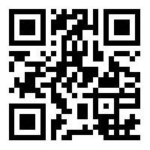
Join the PSUG Slack TEAM
We’re here:
https://get-psuguk.herokuapp.com
Or
http://bit.ly/2eQyxOD

Slide 32
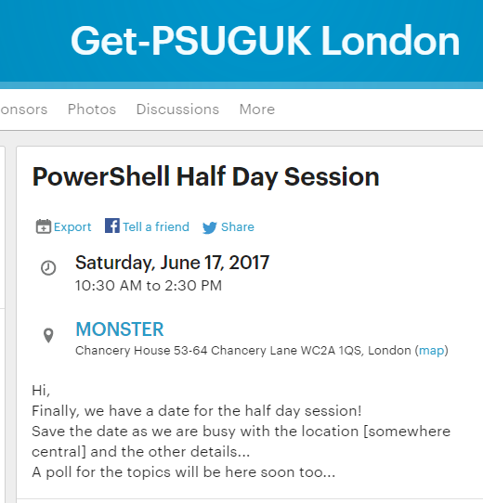
Other events Part 1
PowerShell Half Day
Saturday 17th of June
Track 1: Easy
Track 2: Intermediate

Slide 33

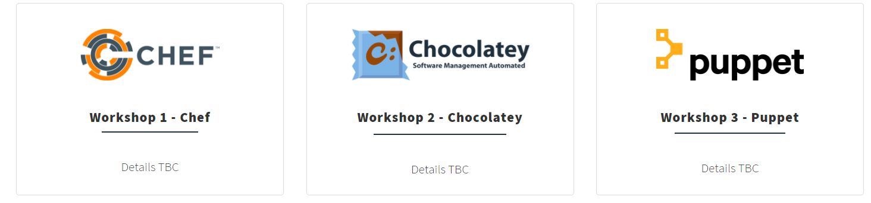
Other events Part 2
WinOps 2017
Wed 20 – Thr 21st September

Slide 34

SAVE PLANET CODE – GO GREEN
Reduce
Code size reduces
Readability increases
Code Size
Readability
Complexity
Maintainability
Complexity reduces
Maintainability increases

Slide 35
SAVE PLANET CODE – GO GREEN
Reuse
Focus narrows
Reusability increases
Focus
Reusability
Unreliability
Reuse
Reuse increases
Potential for bugs & unreliability decreases

Slide 36
SAVE PLANET CODE – GO GREEN
Steal from the best, write the rest. – Ed Wilson, The Scripting Guy
Recycle
Documenting increases
Ability to
Use modules
Focus
Reusability
Unreliability
Reuse
Reuse increases
Potential for bugs & unreliability decreases

Slide 37

resources
PowerShell Practice & Style Guide
https://github.com/PoshCode/PowerShellPracticeAndStyle
PowerShell + DevOps Global Summit 2017
PowerShell Conference EU
Azure Cloud Shell – PowerShell version in preview
http://aka.ms/pscloudsignup

Slide 38
Hurry up and move on!

